Slide 1
Why we need CSS Speech
Frontend RheinMain A11y campside chat

Slide 2
Why we design things

Slide 3

Innovation

Slide 4

Recognition

Slide 5

Experience

Slide 6
Why we design web things

Slide 7
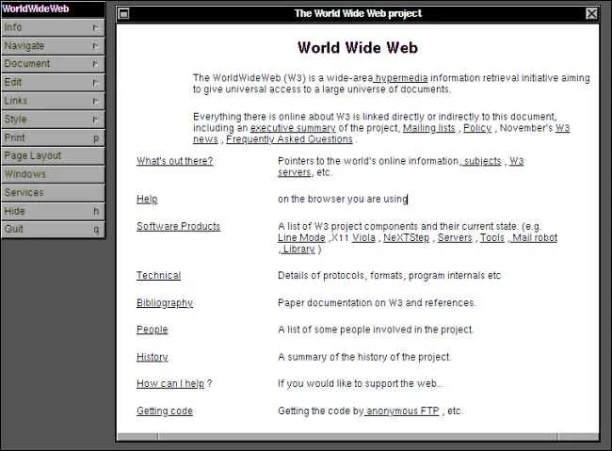
Innovation

Slide 8

Recognition

Slide 9
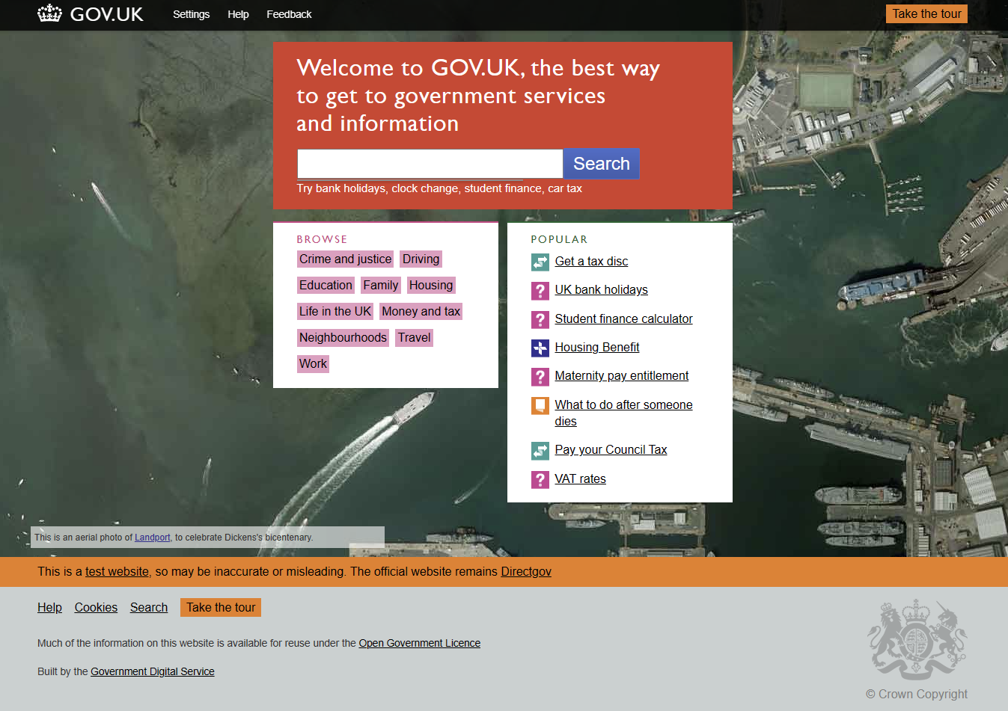
Experience

Slide 10
Why we choose voices

Slide 11


Innovation

Slide 12

Recognition

Slide 13

Experience

Slide 14
Why we need CSS Speech

Slide 15
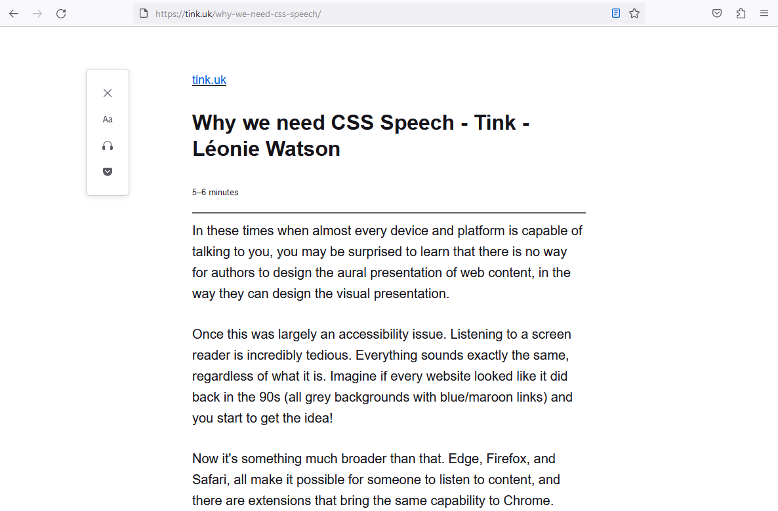
Innovation

Slide 16

Recognition

Slide 17

Experience

Slide 18
Where you find more information

Slide 19
CSS Speech specification
https://www.w3.org/TR/css-speech-1/

Slide 20
Blog posts
Why we need CSS Speech:
https://tink.uk/why-we-need-css-speech/
Addressing concerns about CSS Speech:
https://tink.uk/addressing-concerns-about-css-speech/

Slide 21
Why we need CSS Speech
Thank you

